Slide 1
--**WELCOME**--
--**This is mini project**--

Slide 2

A Presentation on PYTHON PROGRAMMING with Mini Project
GROUP MEMBER’S ROLL NO.
Arun Prajapati :- 1835110067
Vaishnavi Dixit :- 1835110052
Upasna Rathore :- 1835110050
Rahul Gautam :- 1835110069

Slide 3
Submitted to: Submitted by:
Mr. Ankit Srivastav :- Arun Prajapati
(Asst. professor) :- Vaishnavi Dixit
Mr. Manish Chaudhary :- Upasna Rathore
(Head of Department) :- Rahul Gautam
Mr. Anuj Khanna
(Asst. professor)

Slide 4
DATE OF SUBMISSION
27 JANUARY 2021

Slide 5
ACKNOWLEDGEMENT
It is with the great sense of satisfaction that we present our Knowledge about Python Programming language in the form of project work. We are fortunate to have a teacher’s and mentor’s who are so helpful to us.
While working on this project, their patience and valuable hints helped us during the problems. They were generous enough to lead me with their Time, Experience and Expertise.
I also acknowledge, with great thanks to our HOD SIR and our faculty for their suggestions and encouragement that I was provided by him at different stages while working on this project and also other staff members for all their help that they extended me.
Last but not the least, I also thank full to all the Group Members of the project to complete this project before the deadline which was given to us.

Slide 6
TABLE OF CONTENTS
Abstract…………………………
Python Introduction…………….
Python Details………………….
Module 1…………………………
Python History
Python Installation
Python Variables
Module 2…………………………
Python Syntax
Python Operator’s
Module 3…………………………
Python Data Types
Module 4…………………………
Python MYSQL
Mini Project

Slide 7
1. ABSTRACT
This report about the concept Of Python programming language with the help Of the Mini Project.
It shows my knowledge about Python language with the help of which I have made an Project where the concepts of Python programming is used.
The report describes about the history, characteristics, overview and concepts of python programming.

Slide 8
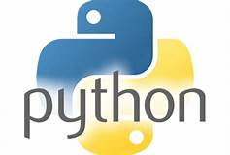
2. PYTHON INTRODUCTION
DEFINITION
What does Python mean? Python is a multipurpose, general-purpose, interpreted, high-level programming language. Python allows programmers to use different programming styles to create simple or complex programs, get quicker results and write code almost as if speaking in a human language. Some of the popular systems and applications that have employed Python during development include Google Search, YouTube, BitTorrent, Google App Engine, Eve Online, Maya and iRobot machines.

Slide 9
3. PYTHON DETAILS
Python Fundamentals And Programming
Functions
Strings, Tuple and Lists
Conditional Execution and Loops
Dictionaries and Sets
Modules
Intermediate Python
Object Oriented Programming
File Handling
Iterators, Generators and Decorators
Advanced Python
Building Framework

Slide 10
C Code in Python
Writing Library
Closure, method chaining and function factory
Python in C#
Metaclasses, Introspection
Python in JAVA

Slide 11
MODULE 1
PYTHON HISTORY
PYTHON INSTALLATION
VARIABLES
CASTING

Slide 12
PYTHON HISTORY
The programming language Python was conceived in the late 1980s,[1] and its implementation was started in December 1989[2] by Guido van Rossum at CWI in the Netherlands as a successor to ABC capable of exception handling and interfacing with the Amoeba operating system. Van Rossum is Python's principal author, and his continuing central role in deciding the direction of Python is reflected in the title given to him by the Python community, Benevolent Dictator for Life (BDFL). (However, van Rossum stepped down as leader on July 12, 2018. ). Python was named after the BBC TV show Monty Python's Flying Circus.
Python 2.0 was released on October 16, 2000, with many major new features, including a cycle-detecting garbage collector for memory management and support for Unicode. However, the most important change was to the development process itself, with a shift to a more transparent and community-backed process.

Slide 13
PYTHON INSTALLATION
Four Python 3.9 installers are available for download - two each for the 32-bit and 64-bit versions of the interpreter. The web installer is a small initial download, and it will automatically download the required components as necessary. The offline installer includes the components necessary for a default installation and only requires an internet connection for optional features. See Installing Without Downloading for other ways to avoid downloading during installation.

Slide 14
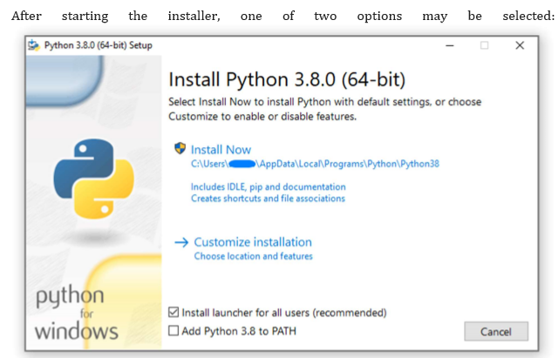

Slide 15
If you select “Install Now”:
You will not need to be an administrator (unless a system update for the C Runtime Library is required or you install the Python Launcher for Windows for all users) .
Python will be installed into your user directory .
The Python Launcher for Windows will be installed according to the option at the bottom of the first page .
The standard library, test suite, launcher and pip will be installed .

Slide 16
VARIABLES
PYTHON VARIABLES
Variable are containers for storing data values.
CREATING VARIABLES
Python has no command for declaring a variable.
A variable is created the moment you first assign a value to it.
EXAMPLE
X = 5
Y = “john”
print(X)
Variable do not need to be declared with any particular type, and can even change type
after they have been set.

Slide 17
CASTING
If you want to specify the data type of a variable , this can be done with casting.
EXAMPLE
X = str(3) # x will be ‘3’
Y = int(3) # y will be ‘3’
Z = float(3) # z will be ‘3.0’

Slide 18
MODULE 2
PYTHON SYNTAX
PYTHON OPERATOR’S
LIST

Slide 19
PYTHON SYNTAX
Execute Python Syntax
As we learned in the previous page, Python syntax can be
executed by writing directly in the Command Line:
>>>print("Hello, World!")
Hello, World!
Or by creating a python file on the server, using the
.py file extension, and running it in the Command Line:
C:\Users\Your Name>python myfile.py

Slide 20
PYTHON OPERATOR’S
Python divides the operators in the following groups:
Arithmetic operators
Assignment operators
Comparison operators
Logical operators
Identity operators
Membership operators
Bitwise operators

Slide 21
LIST
Lists are used to store multiple items in a single variable.
Lists are one of 4 built-in data types in Python used to store collections of data, the other 3 are Tuple, Set, and Dictionary, all with different qualities and usage.
Lists are created using square brackets.
EXAMPLE :
Create a List:
thislist = ["apple", "banana", "cherry"]
print(thislist)

Slide 22
MODULE 3
BUILT-IN DATA TYPES

Slide 23
BUILT-IN DATA TYPES
In programming, data type is an important concept. Variables can store data of different types, and different types can do different things. Python has the following data types built-in by default, in these categories:
Text Type: Str
Numeric Types: int, float, complex
Sequence Types: list, tuple, range
Mapping Type: Dict
Set Types: set, frozenset
Boolean Type: Bool
Binary Types: bytes, bytearray, memoryview

Slide 24
MODULE 4
PYTHON MYSQL
INSTALL MYSQL DRIVER’S

Slide 25
PYTHON MYSQL
Python can be used in database applications.
One of the most popular databases is MySQL.
MySQL Database
To be able to experiment with the code examples in this tutorial, you should
have MySQL installed on your computer.
You can download a free MySQL database
at https://www.mysql.com/downloads/ .

Slide 26
INSTALL MYSQL DRIVER
Python needs a MySQL driver to access the MySQL database.
In this tutorial we will use the driver "MySQL Connector".
We recommend that you use PIP to install "MySQL Connector".
PIP is most likely already installed in your Python environment.
Navigate your command line to the location of PIP, and type the following:
Download and install "MySQL Connector":
C:\Users\Your Name\AppData\Local\Programs\Python\Python3632\Scripts>python -m pip install mysql-connector-python .

Slide 27
--**PROJECT WORK**--
INTRODUCTION OF PROJECT
PROCESS
PROGRAM CODE
CONCLUSION

Slide 28
CONTENTS
INTRODUCTION
DESCRIPTION OF DICE ROLLING SIMULATOR IN PYTHON
PROCESS ,TECHNOLOGY AND LIBRARY USED
HOW TO ROLL A DICE
PROGRAM CODE
OUTPUT
CONCLUSION

Slide 29
INTRODUCTION OF PROJECT
In this project, we are making a very basic dice roll simulator in Python.
Dice roll simulator with a Python programming language is easy to make and implement. And this is a very simple program where users can play and make the game easier. So, dice roll simulator in a python programming language where a random number is used and using python as a programming language, you can easily build command line games.
When the program runs, it will randomly choose a number between 1 to 6 .The program will point what the number is. It will then ask you if you did like to roll again you need to enter ‘yes’ or ‘y’ to continue typing ‘no’ or ‘n’ will quit this program validation is added for all other Inputs.

Slide 30
DESCRIPTION
We all know about Dice. It is a simple cube with numbers from 1 to 6 Written on its face. But what is simulation? It is making a computer model. Thus, a dice simulator is a simple computer model that can roll a dice for us .
We aim to built a dice simulator which looks like:
[- - - - -]
[0 0 0 ]
[ ]
[0 0 0 ]
[- - - - -]

Slide 31
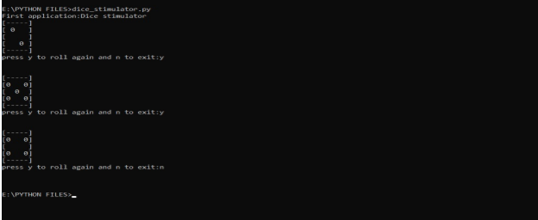

Slide 32
PROCESS
You have to Install python 2.0 or above version to run this program.
And you have to install python IDE.
Have to install random library.
So install all the required library .
Run the program to get the accepted result .
TECHNOLOGY USED :
Python 3.8
LIBRARY USED :
RANDOM LIBRARY

Slide 33
HOW TO ROLL A DICE USING PYTHON
The following instructions will guide you on how to create a Python module for ”Rolling the dice”. This module will generate random numbers from this computerized dice.
We will provide functions needed to create the module and provide a description as to what functions will be used for. Learning the basic for python overwhelming. This will be a creative way of using python to allow you to become more familiar with python.
STEP 1: Import random module
import random
First open an IDE file. Once it is open, import the random module.
STEP 2: Initialize the variable for repeating the program
x = "y"
After Import the random module we have initialize a variable x=”y” .

Slide 34
STEP 3: Create a loop
while x == "y":
Ensures that the while loop command is true initially.
STEP 4: Use randint() function
no = random.randint(1,6)
What is randint() in python?
The randint() method returns on integer number Selected element from the specified range (1-6).
Now we can use the randint() in the random library to generate a random variable.
STEP 5: RUNNING THE PROGRAM FOR FIRST TIME
Our code now print a random output between 1-6 each time the program is run. If we run the program 3 times our output will look like :

Slide 35
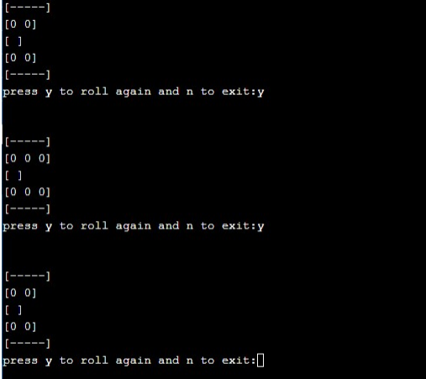

Slide 36
STEP 6: Ask the user for another dice roll
We will use the input() function to obtain the user input. The user will be prompted “press y to roll again and n to exit:”. We only need to know whether the answer is yes. If the answer is no then obviously it is no.
The input of the user will be stand in a variable so that we can check whether the input is “y” for now.
We will use a while loop that runs while the value of variable which we will call is true.
Inside the while loop , we will print a random dice roll to the screen, then ask the user for another dice roll:
x = "y"
while x == "y":
STEP 7: Running the program
We can run the program in the terminal with the command python 3 dice_roll.py and we will be given a random dice roll and then immediately ask if we want to roll dice again.
If we type ‘y’ we will get another dice roll and then when we type anything other then ‘y’ we will quit terminate the program .

Slide 37
PROGRAM CODE
Import random
X = “y”
While x == “y”:
#Generate a random number
#Between 1 and 6 (including both 1 and 6)
no == random.randint(1,6)
if no == 1:
print(“[-----]”)
print(“[]”)
print(“[0]”)
print(“[]”)

Slide 38
print("[-----]")
if no == 2:
print("[-----]")
print("[ 0 ]")
print("[ ]")
print("[ 0 ]")
print("[-----]")
if no == 3:
print("[-----]")
print("[ ]")
print("[0 0 0]")
print("[ ]")
print("[-----]")
if no == 4:
print("[-----]")
print("[0 0]")
print("[ ]")
print("[0 0]")
print("[-----]")
if no == 5:
print(“[-----]”)
print(“[0 0 ]”)

Slide 39
print("[ 0 ]")
print("[0 0]")
print("[-----]")
if no == 6:
print("[-----]")
print("[0 0 0]")
print("[ ]")
print("[0 0 0]")
print("[-----]")
x=input("press y to roll again and n to exit:")
print("\n")
OUTPUT:

Slide 40
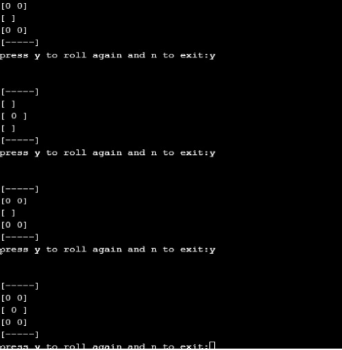

Slide 41
CONCLUSION
In this project, we went through the steps of counting a command line dice roll simulator in python. There are different ways of doing the same thing but this is the way we choose to do a dice roll simulator in python you can try and mix a few thing up as an exercise.
I suggest you to try and improve this dice roll simulator on your own. It would be a good test of your python programming language.

Slide 42
--**THE END**--
--**THANK YOU**--

